Slide 1

Information Literacy: Database University of South Dakota Library. University of South Dakota, 2013. Web. 01 Oct. 2013.

Slide 2
What is a database?
A database is a searchable collection of closed articles: meaning, they have been screened.
Database vs. Search Engine
Articles in a database have been screened and accepted after adhering to a specific set of criteria.
Search Engines scour the web and find any kind of article regardless of academic merit or value.

Slide 3
Academic Search Premier
Academic Search Premier is the most commonly used multi-subject database.
Through advanced search options or “limiters,” you can narrow down your search and find content specific to your paper topic.
Limiters
Full Text
All or a preview of the text.
Peer Reviewed
Only articles that have been reviewed by experts.
Publication
Search for a specific publication.
Publication Date
Choose a date range to search.

Slide 4
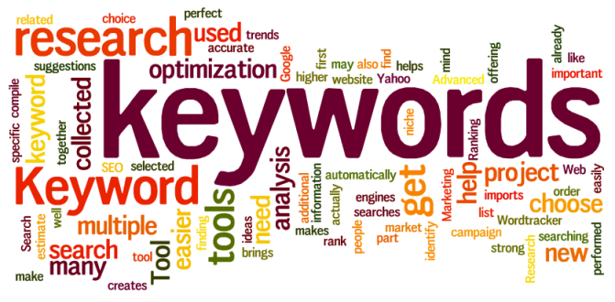
Getting ready to search
Keyword search
Most databases do not respond to sentences or questions.
Use key words to help find articles related to your topic.
The more key words you use, the narrower your results will be.

Slide 5
Boolean operators
There are three Boolean Operator terms:
AND
OR
NOT
AND: Tells the database to search for both the keyword AND the additional word typed.
OR: Tells the database to search for either word typed. Ex: Childhood Obesity. The database would pull articles about childhood, childhood obesity, and obesity.
NOT: Tells the database to search for the keyword and NOT the additional word typed.

Slide 6
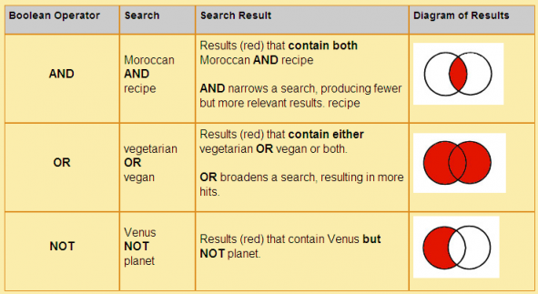
Boolean Operators

Slide 7
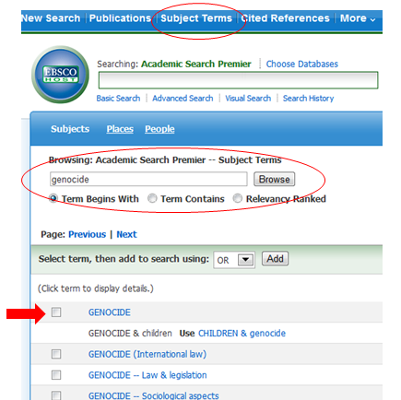
Subject terms
It is also possible to browse a list of subjects.
Simply click on Subject Terms located in the top bar of your screen.
Enter your keyword or phrase and select a subject from the list that is found.

Slide 8

Truncation
By adding an asterisk at the end of your keyword, it tells the database to search for words that have the same prefix but different endings.
Example: Teach* - The search results will bring up articles featuring the words teach, teacher, teaching, etc…

Slide 9
Article formats
Articles can be viewed in two electronic formats.
HTML
PDF
HMTL: This means that the information was taken from a site and loaded into the database. Pictures and graphs may be missing
PDF: Means that the document pages were scanned into the database and the document will be complete with pictures, graphs, and charts.

